Slide 1

FINANCIAL INSTRUMENTS
Dr. Naresh Chandra Sahu
Associate Professor (Economics)
School of Humanities, Social Sciences & Management
Indian Institute of Technology, Bhubaneswar

Slide 2
Learning Outcomes
Explain the concept and purpose of financial instruments in investment, capital raising, and risk management.
Differentiate between equity, debt, and derivative instruments.
Describe the features, advantages, and risks of each type of financial instrument.
Understand how these instruments are issued and traded in different markets.
Interpret examples of financial instruments in real-world contexts.
Explain how market factors like interest rates and risk affect instrument prices.

Slide 3

Financial Instruments
A financial instrument is any asset that can be traded and represents a legal agreement involving monetary value.
Purpose: Used for investment, raising capital, hedging risks, or transferring funds.

Slide 4
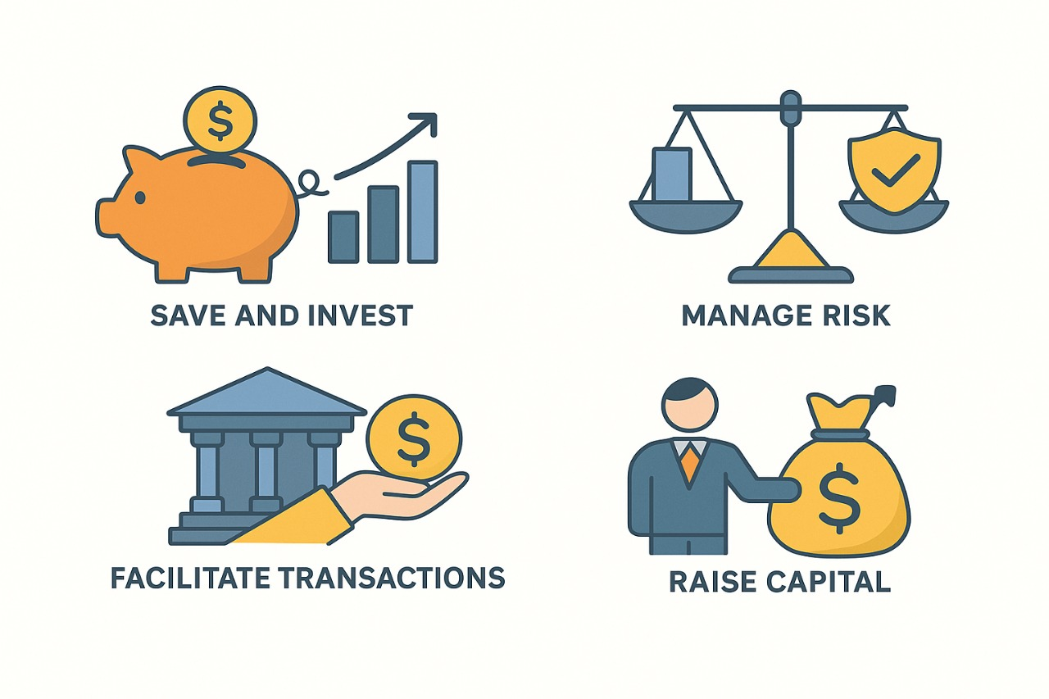
Why do we use Financial Instruments?

Slide 5
Financial Instruments
Types of Financial Instruments
Equity Instruments
Debt Instruments
Derivative Instruments

Slide 6
Equity Instruments
Equity instruments represent ownership interest in a company or entity. When you hold equity, you essentially own a part of that company and have a claim on its assets and earnings.
Key Features of Equity Instruments:
Ownership Rights: Holders are part-owners of the company.
Voting Rights: Usually, equity holders can vote on corporate matters (e.g., electing the board of directors).
Dividends: Equity holders may receive dividends, which are a share of the company’s profits.
Capital Gains: Investors may earn returns through an increase in share price.
Residual Claim: In case of company liquidation, equity holders get paid after all debts are settled.
Risk: Higher risk compared to debt because equity returns depend on company performance and market conditions.

Slide 7
Types of Equity Instruments
a. Common Equity
Ownership in a company through common shares.
Gives voting rights and potential dividends.
Residual claim on assets after debt and preferred equity.
Example: Shares of TCS, Infosys, Apple, Reliance Industries, HDFC Bank.
b. Preferred Equity (Preferred Stock)
Hybrid between equity and debt.
They receive fixed dividends but have no voting rights.
Higher claim than common equity in liquidation.
Example: Preferred shares in Tata Capital

Slide 8
Types of Equity Instruments
c. Private Equity
Investment in private (non-public) companies.
Includes buyouts, venture capital, and growth equity.
Usually provided by private equity firms or venture capitalists.
Example: Blackstone investing in Indian startups
d. Venture Capital
A form of private equity focused on startups and early-stage companies.
High risk, high reward.
Example: Sequoia Capital funding Byju’s

Slide 9
Types of Equity Instruments
e. Shareholders’ Equity
Total equity interest of shareholders in a company.
Found on a company’s balance sheet: Assets – Liabilities = Shareholders’ Equity
f. Retained Earnings (Part of Equity)
Profits a company keeps instead of paying out as dividends.
Used to finance growth, pay debt, or buy back shares.
Appears in the equity section of the balance sheet.

Slide 10
How are Equity Instruments Traded?
Stock Exchanges: Publicly traded equities are bought and sold on stock markets (e.g., NSE, BSE).
Over-the-Counter (OTC): Some shares, especially in smaller companies, are traded OTC.
Initial Public Offering (IPO): When a company offers its shares to the public for the first time.
Secondary Market: Where investors trade shares after the IPO.

Slide 11
Example of Equity Instruments
Shares of Public Companies: Apple, Google, Tesla stocks.
Preferred Shares: Often issued by banks and utilities.
Equity Mutual Funds: Pooled investments in various stocks.
Employee Stock Options: Rights given to employees to buy company stock.

Slide 12
Advantages of Equity Instruments
Potential for High Returns: Through dividends and price appreciation.
Ownership & Control: Voting rights allow influence over company decisions.
Liquidity: Publicly traded stocks are generally liquid.
No Fixed Obligation: Unlike debt, companies don’t have to pay dividends if they don’t want to.

Slide 13
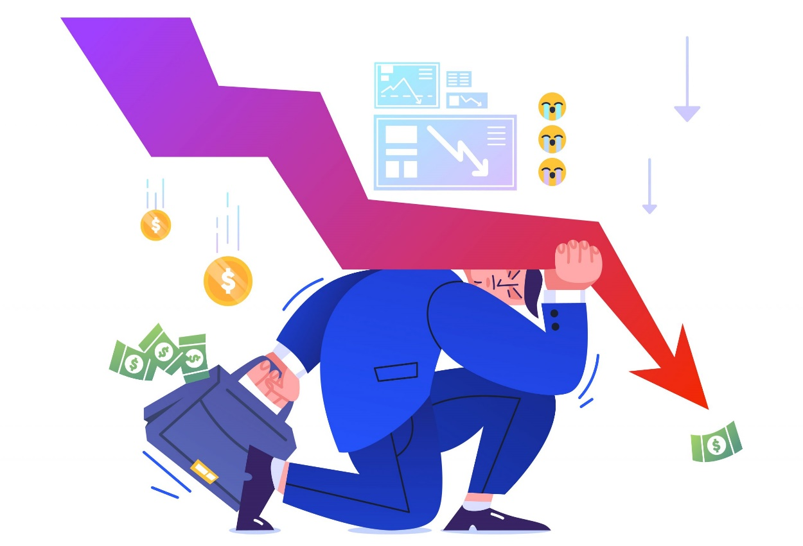
Risk Associated with Equity
Market Risk: Share prices can be volatile.
Business Risk: Company performance affects returns.
Dividend Risk: Dividends are not guaranteed and can be cut.
Dilution: Issuance of new shares may dilute ownership.

Slide 14
Debt Instruments
What Are Debt Instruments?
Debt instruments are financial contracts that represent a loan made by an investor to a borrower (such as a corporation, government, or individual). The borrower promises to repay the principal amount along with interest on specified dates.
In other words, debt instruments are borrowings where the issuer owes the holder money and must pay interest and principal back.

Slide 15
Key Features of Debt Instruments
Fixed Income: Investors receive interest (coupon payments) periodically.
Repayment of Principal: The original amount (principal) is returned at maturity.
Maturity Date: Debt instruments have a defined term or maturity when the principal is repaid.
Credit Risk: The risk that the borrower may default on payments.
Priority: Debt holders have priority over equity holders in case of liquidation.
Lower Risk Compared to Equity: Because of fixed payments and a priority claim.

Slide 16
Types of Debt Instruments
Bonds
Debenture
Certificate of Deposit(CDs)
Commercial Paper

Slide 17






What are Bonds?
And is paid back to the investor as principal amount and interest
A bond
Is issued by a government or corporation
To generate funds

Slide 18
What are Bonds?
A bond is a debt security or loan agreement.
Issued by entities like governments, corporations, or municipalities.
Purpose: To raise funds from investors.
Investors receive:
Periodic interest payments (called coupons).
Return of the principal amount at maturity.
Essentially, a bond is a way for the issuer to borrow money from investors.

Slide 19
Key Features of Bonds
Issuer: The entity borrowing the funds (e.g., government, corporation).
Face Value (Par Value): The principal amount the issuer promises to pay back at maturity, usually 1000 per bond.
Coupon Rate: The interest rate paid to bondholders, typically annually or semi-annually.
Coupon Payment: Actual interest payment amount based on coupon rate and face value.
Maturity Date: The date when the issuer must repay the face value to bondholders.
Price: Bonds can be traded in the secondary market, and prices can vary from face value.
Yield: The return an investor earns on a bond, based on the price paid and coupon payments.

Slide 20
Types of Bonds
1. Government Bonds
Issued by national governments.
Considered very safe (e.g., Government Securities).
Examples: Treasury Bills (short-term), Treasury Notes, Treasury Bonds (long-term).
2. Municipal Bonds
Issued by states, cities, or local governments.
Often tax-exempt on interest income.
Used to fund public projects.

Slide 21
Types of Bonds
3. Corporate Bonds
Issued by companies to raise capital.
Riskier than government bonds; higher yields.
Can be investment grade or high-yield (junk bonds).
4. Zero-Coupon Bonds
Pay no periodic interest.
Sold at a discount to face value.
Full face value paid at maturity.
5. Convertible Bonds
Can be converted into a predetermined number of company shares.

Slide 22
Types of Bonds
6 . Fixed-Rate Bonds
A fixed-rate bond pays a constant interest rate, giving the bondholder the same regular interest payments regardless of market rate changes.
Bond price is sensitive to interest rate changes
Popular with conservative investors
7. Floating-Rate Bonds
A floating-rate bond pays variable interest linked to a benchmark rate( MIBOR,SOFR,URIBOR,TONA, TIBOR,) with coupons resetting periodically based on that rate.
Interest income changes with market rates
Suitable in volatile or rising rate environments

Slide 23
Types of Bonds
8. Call Bond ( Callable Bond) :
A call bond (or callable bond) is a bond that gives the issuer the right to redeem (call back) the bond before its maturity date.
The issuer usually calls the bond at a predetermined call price, often above the face value.
9. Put Bond (Putable Bond) :
A put bond (putable bond) gives the investor the right to sell (put) the bond back to the issuer before maturity.
The investor can exercise this right at specified put dates.
The put price is usually at or near the bond’s face value.

Slide 24
Example of Bonds
Example
Suppose you buy a bond with:
Face Value = 1,000
Coupon Rate = 6% annually
Maturity = 5 years
Market Price = 950
Coupon Payment: 6% × 1,000 = 60 per year
You will receive 60 every year for 5 years, plus 1,000 at the end of year 5

Slide 25
Bond Pricing and Yield
When interest rates fall, bond prices rise, and vice versa.
If a bond is priced above par, the yield is lower than the coupon rate.
If priced below par, the yield is higher than the coupon rate.
Yield to Maturity (YTM): The total return expected if held until maturity, including all coupon payments and any capital gain/loss.

Slide 26
Advantages of Bonds
Regular Income: Predictable interest payments.
Safety: Especially government and high-grade bonds.
Diversification: Bonds balance riskier assets in portfolios.
Capital Preservation: Face value repaid at maturity (if no default).

Slide 27

Risks of Bonds
Interest Rate Risk: Bond prices fall when interest rates rise.
Credit Risk: Risk of issuer defaulting on payments.
Inflation Risk: Fixed payments lose purchasing power.
Liquidity Risk: Some bonds are hard to sell quickly without price concessions.

Slide 28
What is a Debenture?
A debenture is a type of debt instrument that companies use to borrow money from the public or investors. It is an unsecured loan certificate, meaning it is not backed by any collateral (assets). Instead, the company’s creditworthiness and reputation back the debenture.
In simple terms, when you buy a debenture, you are lending money to the company, which promises to pay back the principal with interest at a specified date.

Slide 29
Key Features of Debentures?
Unsecured: No specific asset is pledged as security.
Fixed Interest: Pays fixed or floating rate interest (called coupon).
Maturity Date: Principal is repaid on a fixed maturity date.
Issuer: Usually issued by companies to raise long-term funds.
Transferability: Can be traded on stock exchanges or OTC.
Credit Risk: Depends on the issuer’s financial health.
Priority: Debenture holders have priority over equity shareholders, but after secured creditors in liquidation.

Slide 30
Types of Debentures
1. Convertible Debentures
Can be converted into equity shares of the issuing company after a specified period or under certain conditions.
Offers investors potential upside if the company performs well.
2. Non-Convertible Debentures (NCDs)
Cannot be converted into equity shares.
Typically offer higher interest rates to compensate for the lack of a conversion feature.
3. Secured Debentures
Though debentures are generally unsecured, sometimes companies issue secured debentures backed by assets.

Slide 31
Types of Debentures
4. Unsecured Debentures
Most common form, without asset backing.
5. Redeemable and Irredeemable Debentures
Redeemable: Has a maturity date when principal is repaid.
Irredeemable (Perpetual): No fixed maturity date; pays interest indefinitely.

Slide 32
How Debenture Work?
The company issues debentures to raise capital.
Investors buy debentures and receive regular interest payments (coupons).
At maturity, the company repays the principal amount.
If the company defaults, debenture holders have a claim on assets (after secured creditors).

Slide 33
Advantages of Debenture
For Companies: Easier to raise funds without diluting ownership.
For Investors: Regular income through interest payments.
Tradable: Many debentures can be sold in secondary markets.
Priority: Debenture holders have priority over shareholders in liquidation.

Slide 34
Risks of Debenture
Credit Risk: Possibility of issuer default.
Interest Rate Risk: Prices of debentures fall when interest rates rise.
Liquidity Risk: Some debentures may be hard to sell.
No Ownership: Debenture holders do not get voting rights or ownership

Slide 35
Bond vs Debenture
Point of Comparison | Bonds | Debentures
Definition | Debt secured by assets | Unsecured corporate debt
Security | Backed by collateral | Not backed by collateral
Issuer | Government or corporations | Only corporations
Risk Level | Lower risk | Higher risk
Interest Rate | Lower interest | Higher interest

Slide 36
What is Commercial Paper?
Commercial Paper (CP) is a short-term, unsecured debt instrument issued by corporations to meet their immediate funding needs, like working capital, payroll, or inventory purchase.
It is a promissory note issued at a discount and redeemed at face value on maturity. It’s a way for companies to borrow money directly from investors without going through banks.

Slide 37
Key Features of Commercial Paper
Short-term maturity: Typically from 1 day up to 270 days (usually less than 3 months).
Unsecured: No collateral backing; based solely on issuer’s creditworthiness.
Issued at Discount: Sold below face value; redeemed at face value at maturity.
Issued by Corporations: Usually large, financially strong companies.
Denominations: Generally large (e.g., 100,000 or more).
Tradable: Can be sold in secondary markets but mostly held till maturity.
No periodic interest: Return comes from the difference between the purchase price and face value.

Slide 38
Commercial Paper
Advantages of Commercial Paper
Low Cost: Usually cheaper than bank loans.
Quick Access: Faster to issue compared to bonds or bank loans.
Flexibility: Short maturities allow tailored funding needs.
No Collateral: Easier to raise funds without asset backing.
Risks of Commercial Paper
Credit Risk: No collateral, so default risk depends on the issuer’s credit rating.
Liquidity Risk: Secondary market might be thin; hard to sell before maturity.
Maturity Limit: Cannot be issued for more than 270 days.

Slide 39
Certificate of Deposit(CDs)
What is a Certificate of Deposit (CD)?
A Certificate of Deposit (CD) is a time deposit offered by banks and financial institutions. It’s a savings product where you deposit a fixed amount of money for a predetermined period, and in return, the bank pays you interest at a fixed or variable rate.
Unlike regular savings accounts, CDs lock your money for the agreed term, and you usually can’t withdraw early without penalties.

Slide 40
Key Features of Certificates of Deposit
Fixed Term: Maturity periods range from a few months to several years (commonly 3 months to 5 years).
Fixed Interest Rate: Pays a predetermined interest rate, often higher than regular savings accounts.
Principal Protection: Your initial deposit is safe and guaranteed by the bank.
Early Withdrawal Penalties: Withdrawing before maturity may result in interest penalties.
Tradability: Most CDs are non-transferable, but some brokered CDs can be sold in secondary markets.

Slide 41
Types of Certificate of Deposit
1. Traditional CDs
Fixed term and fixed interest.
Interest paid at maturity or periodically.
2. Jumbo CDs
Large denomination CDs.
Often offer higher interest rates.
3. Callable CDs
The bank can “call” or redeem the CD before maturity.
Usually offers higher interest rates to compensate.
4. Brokered CDs
Sold through brokerage firms.
May be traded on secondary markets.
5. Variable Rate CDs
Interest rate adjusts periodically based on market rates.

Slide 42
Certificate of Deposits
Advantages of CDs
Safety: Low risk
Predictable Returns: Fixed interest payments.
Higher Rates: Typically better rates than savings accounts.
Simplicity: Easy to understand and manage.
Disadvantages of CDs
Liquidity: Money is locked until maturity unless you pay penalties.
Inflation Risk: Fixed rates may not keep up with inflation.
Lower Returns: Generally lower than stocks or bonds over long periods.

Slide 43

Derivative Instruments
What is a Derivative?
A derivative is a financial contract whose value is derived from an underlying asset, rate, or index.
It is not an asset itself, but a contract that gains or loses value based on the performance of something else.
Underlying Assets Can Include:
Commodities (e.g., gold, oil, wheat)
Stocks & Indices (e.g., Nifty 50, S&P 500)
Currencies (e.g., INR/USD)
Interest Rates
Bonds
Cryptocurrencies (in some markets)

Slide 44
Types of Derivative Instruments
Future: A future is a standardized financial contract obligating the buyer to purchase, and the seller to sell, an asset at a predetermined price on a specified future date.
Traded on organized exchanges (e.g., NSE, MCX)
Underlying assets can be stocks, commodities, currencies, indices, etc.
Forward: A forward derivative is a private agreement between two parties to buy or sell an asset at a predetermined price on a specified future date. It is customized and traded over-the-counter (OTC), not on an exchange.

Slide 45
Types of Derivative Instruments
Option: An Option is a derivative contract that gives the buyer the right (but not the obligation) to buy or sell an underlying asset at a specific price (strike price) on or before a specified date (expiry date).
The seller (writer) of the option has the obligation if the buyer chooses to exercise the option
Swap: A swap is a derivative contract in which two parties agree to exchange financial cash flows at predetermined intervals, based on different financial instruments such as interest rates, currencies, or commodities.
Swaps are customized contracts and are traded over-the-counter (OTC), not on formal exchanges.

Slide 46
Purpose of Derivative instruments
Hedging – To protect against price fluctuations and reduce risk.
Speculation – To earn profit from expected future price movements.
Arbitrage – To take advantage of price differences in different markets.
Market Access – To gain exposure to assets (like oil, forex) without owning them
Liquidity – To increase market participation and make trading easier.

Slide 47
Derivatives Market
1. Exchange-Traded Derivatives
Standardized contracts (e.g., NSE, BSE in India)
Regulated, with a clearing house (reduces counterparty risk)
2. Over-the-Counter (OTC) Derivatives
Privately negotiated contracts
More flexible but higher counterparty risk

Slide 48
Advantages of Derivative Instruments
Risk management: Reduce exposure to price volatility
Leverage: Amplify returns with less capital
Flexibility: Wide variety of contracts to suit needs
Liquidity: Large and active markets, especially on exchanges

Slide 49
Risks in Derivative Trading
Market risk: Losses due to unfavorable price movements
Leverage risk: Small changes cause large losses or gains
Counterparty risk: Risk that the other party defaults (especially in OTC)
Liquidity risk: Difficulty in closing positions at desired prices
Complexity risk: Derivatives can be complex and hard to understand

Slide 50

NAMASKAR
&
THANK YOU

